Slide 1
PUSH FROM HELL
Como a tecnologia está afetando
nossa produtividade

Slide 2
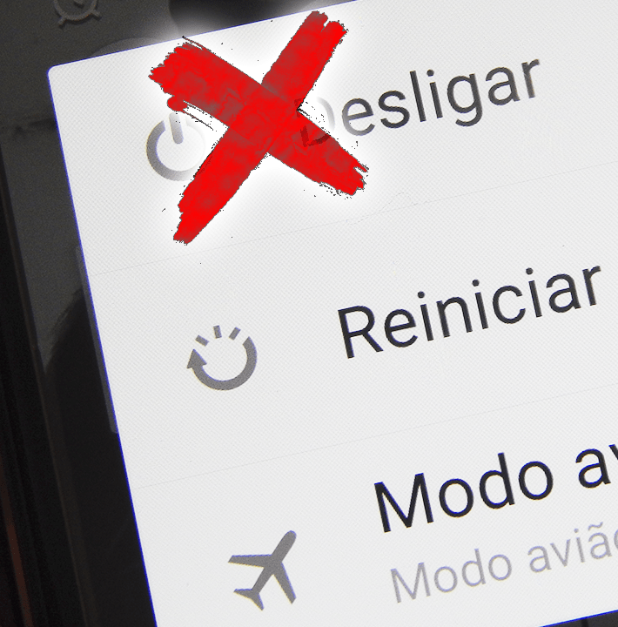
Shutdown...

Slide 3
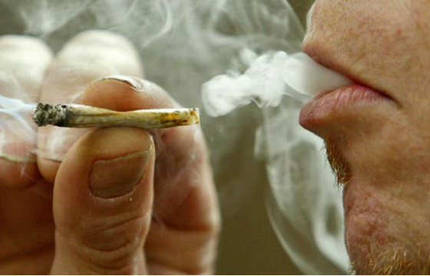
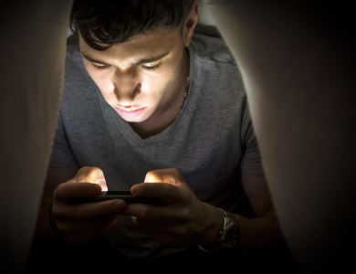
O que eles têm em comum?
VÍCIO

Slide 4
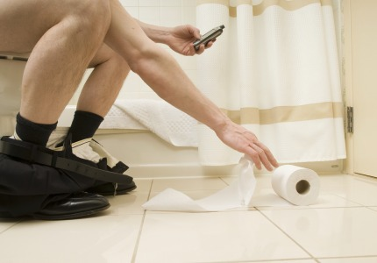

Slide 5
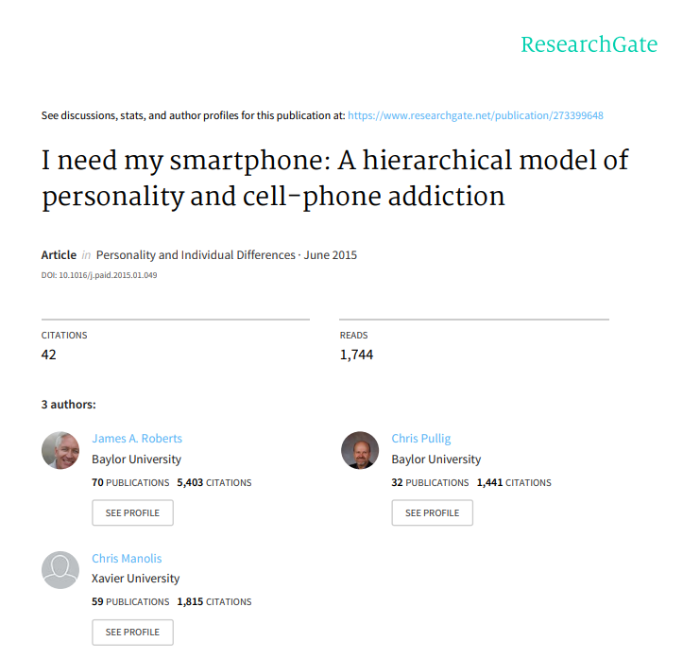
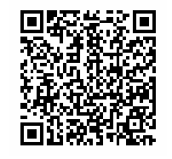

Slide 6
1000+ Estudantes Analisados
Tempo gasto no celular
97 Escrevendo
118 Navegando na internet
41 Facebook
49 Email
51 Falando no telefone
~6 horas

Slide 7
Mowen (2000)
Emotional instability (Mau humor, temperamental, ansiedade)
Introversion (Individuos introvertido)
Need for arousal (Busca constante por excitação)
Materialism (Foco nos bens materiais)
Open to Experience (intelectualmente curiosas, apreciadoras da arte e sensíveis à beleza)
Agreeability (Agradabilidade)
Conscientiousness (autodisciplina)

Slide 8
Resultados
Introversion (Individuos introvertido)
São menos propensos a serem viciados no celular do que os extrovertidos, já que não necessitam da sensação de estarem conectados o tempo inteiro

Slide 9
Resultados
Need for arousal (Busca constante por excitação)
Não possui ligação direta com o vício, apesar de ter fortes características com a impulsividade

Slide 10
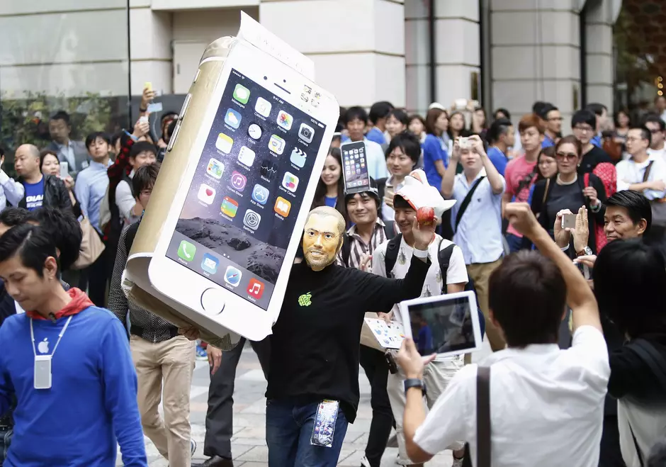
Resultados
Materialism (Foco nos bens materiais)
Apresenta uma probabilidade significativa ao vício, pois veem o celular como algo a mais do que uma simples ferramenta.
Vide a popularização do iPhone

Slide 11
Resultados
Open to Experience (intelectualmente curiosas, apreciadores da arte e sensíveis à beleza)
Apesar de apresentarem relação com a impulsividade, a relação com o vício é fraca

Slide 12
Resultados
Emotional instability (Mau humor, temperamental, ansiedade)
Forte tendência ao vício
Tentam equilibrar seu desequilíbrio com o uso do telefone, checando emails a todo instante, mandando mensagens, tweets, navegando na internet e etc

Slide 13
O vício em smartphones está associado com a dificuldade das pessoas manterem o foco na tarefa que estão fazendo.

Slide 14
Nas situações que estamos passando por alguma dificuldade nas tarefas, os viciados em celular tendem a mudar o foco para o telefone.

Slide 15
Desbloqueamos o telefone de 110 a 150 vezes sem objetivo nenhum.

Slide 16
AS EMPRESAS SABEM DISSO

Slide 17
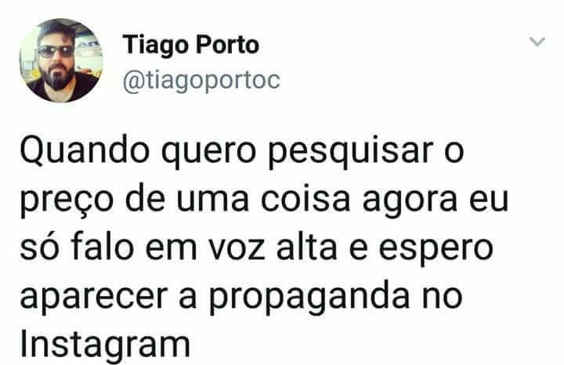

Slide 18
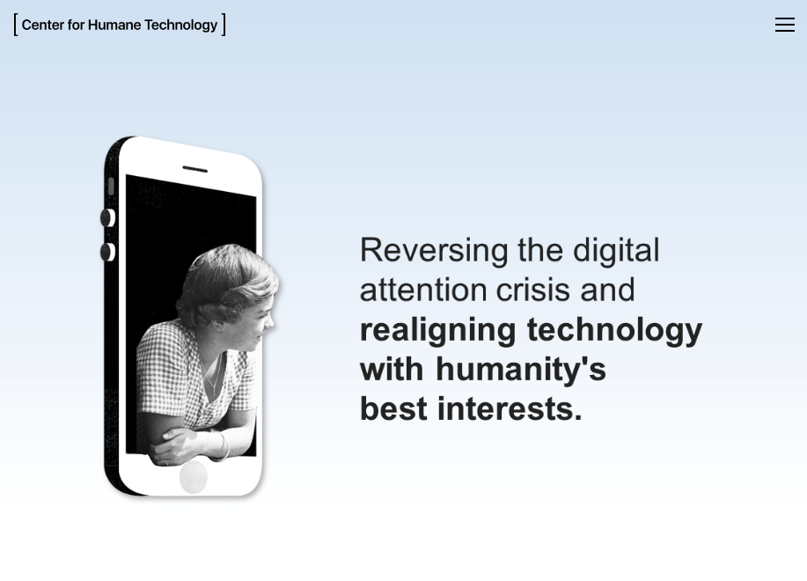
http://humanetech.com/

Slide 19
SAINDO DO VÍCIO

Slide 20
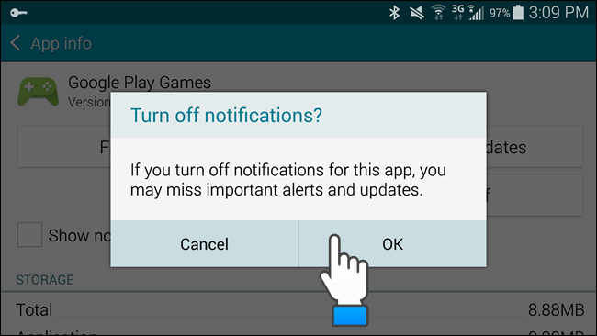
Desligar as Notificações

Slide 21
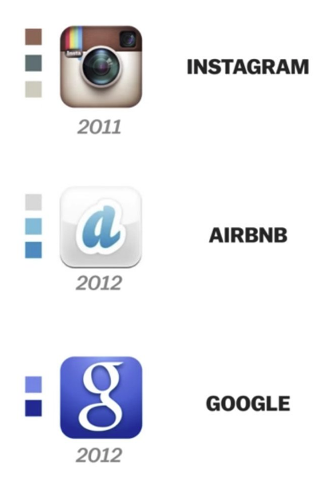
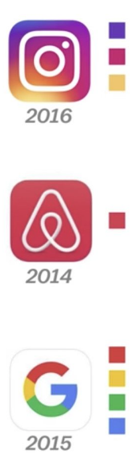
Mude as cores da tela

Slide 22
Mude as cores da tela

Slide 23
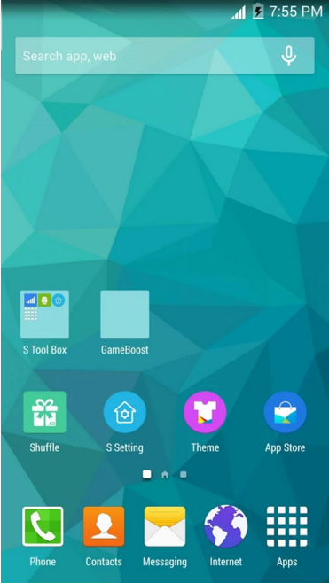
Restringir a tela inicial

Slide 24
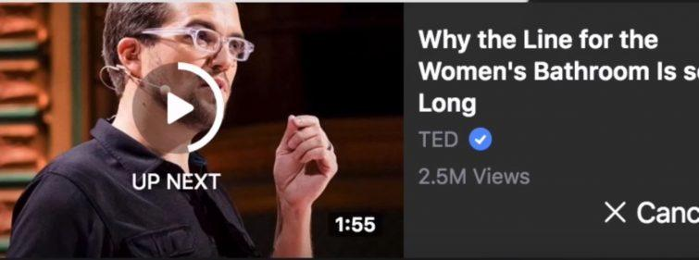
Scroll Infinito e Autoplay

Slide 25
SURVEILLANCE

Slide 26
População
Brasileira
2018
208.735.559 População brasileira às 22:00:03 de 10/3/2018
Fonte: https://www.ibge.gov.br/apps/populacao/projecao/

Slide 27
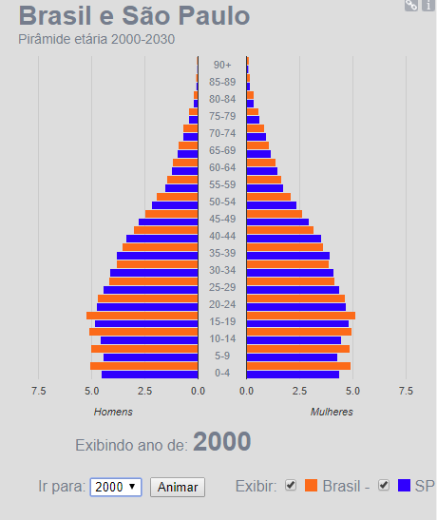
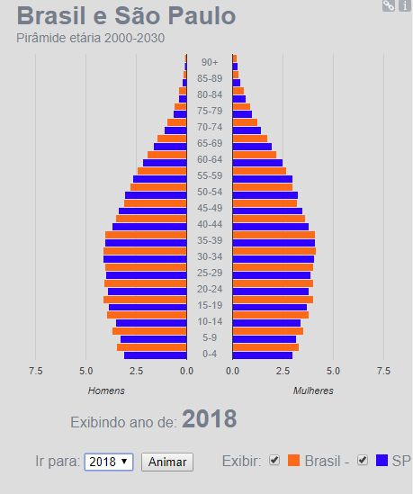
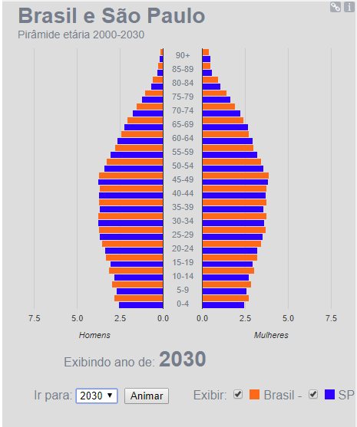

Slide 28
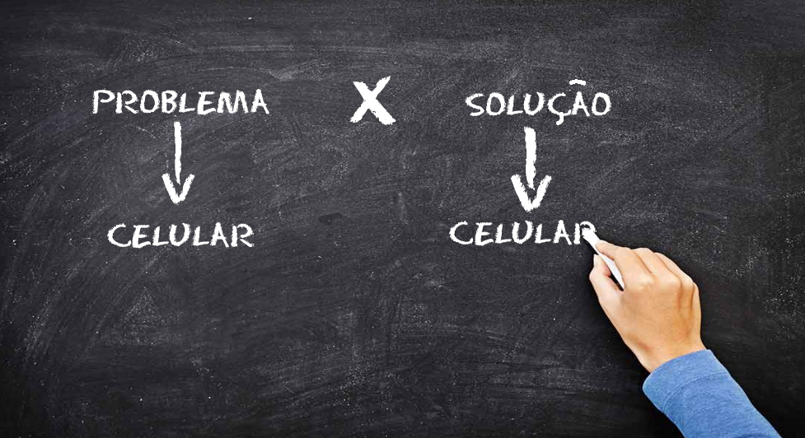

Slide 29
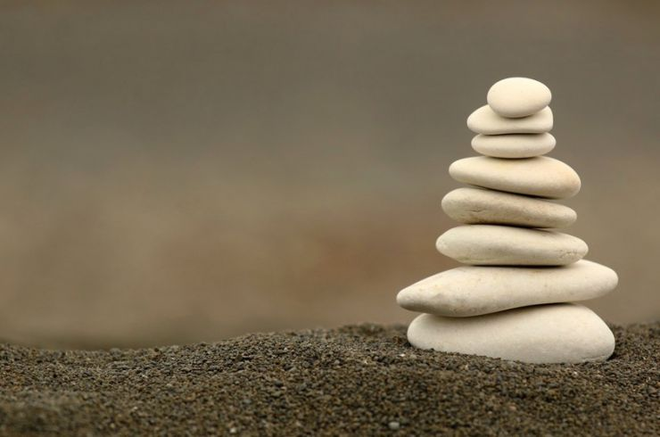
Obrigado!
Jonatan Machado
Contact me at:
github.com/jonatan2m
jonatan.mac@gmail.com
@jonatanmachado

Slide 30

THIS IS YOUR PRESENTATION (OR SLIDEDOC) TITLE

Slide 31
Instructions for use
EDIT IN GOOGLE SLIDES
Click on the button under the presentation preview that says "Use as Google Slides Theme".
You will get a copy of this document on your Google Drive and will be able to edit, add or delete slides.
You have to be signed in to your Google account.
EDIT IN POWERPOINT®
Click on the button under the presentation preview that says "Download as PowerPoint template". You will get a .pptx file that you can edit in PowerPoint.
Remember to download and install the fonts used in this presentation (you’ll find the links to the font files needed in the Presentation design slide)
More info on how to use this template at www.slidescarnival.com/help-use-presentation-template
This template is free to use under Creative Commons Attribution license. You can keep the Credits slide or mention SlidesCarnival and other resources used in a slide footer.

Slide 32
This template is for a SlideDoc
A slidedoc is a visual document, developed in presentation software, that is intended to be read and referenced instead of projected.
Slidedocs help you spread your smart thinking by combining visual communications with short chunks of written copy. Their scannable nature makes them great pre-read, reference, and leave-behind materials. Their modularity makes it easy for people to incorporate your ideas into their own communications. And these features together make slidedocs the perfect companion to both written documents and presentations.
Text from duarte.com/slidedocs

Slide 33
Table of contents
Section one
Section two
Even another section
And there can be subsections too.
Subsection
Section four
This is a template optimized for SlideDocs. As it is a long document you should inform the reader about its contents.

Slide 34
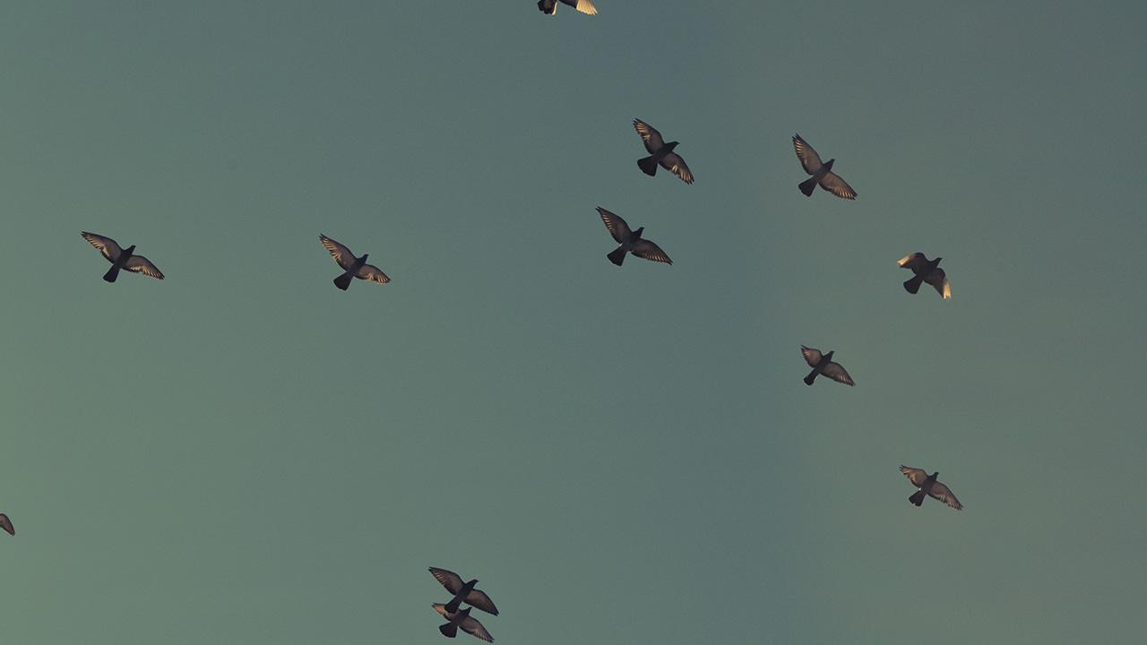
1.
TRANSITION HEADLINE
Let’s start with the first set of slides

Slide 35
Quotations are commonly printed as a means of inspiration and to invoke philosophical thoughts from the reader.

Slide 36
This is a slide title
SlideDocs are for distribution; they’re not optimized for presenting. Slides have too much text and font size is too small for an audience to read it projected in a screen.
These documents are useful for:
Distribute before a meeting when the topic is highly complex or technical
To fully explain your idea before booking a meeting with someone
As a reference and follow-up material
Distribute
Explain
Follow-up

Slide 37
BIG CONCEPT
Bring the attention of your audience over a key concept using icons or illustrations

Slide 38
You can also split your content
Try to communicate ideas visually using graphs, icons, illustrations, photos… any resource that helps you convey your message at a glance.
White
Is the color of milk and fresh snow, the color produced by the combination of all the colors of the visible spectrum.
Black
Is the color of coal, ebony, and of outer space. It is the darkest color, the result of the absence of or complete absorption of light.

Slide 39
In two or three columns
Yellow
Is the color of gold, butter and ripe lemons. In the spectrum of visible light, yellow is found between green and orange.
According to surveys in Europe, Canada, and the United States, yellow is the color people most often associate with amusement, gentleness, and spontaneity, but also with duplicity, envy, jealousy, avarice, and, in the U.S., with cowardice.
It plays an important role in Asian culture, particularly in China, where it is seen as the color of happiness, glory, wisdom, harmony, and culture.
Blue
Is the colour of the clear sky and the deep sea. It is located between violet and green on the optical spectrum.
Surveys in the US and Europe show that blue is the colour most commonly associated with harmony, faithfulness, confidence, distance, infinity, the imagination, cold, and sometimes with sadness.
In US and European public opinion polls it is the most popular colour, chosen by almost half of both men and women as their favourite colour.
Red
Is the color of blood, and because of this it has historically been associated with sacrifice, danger and courage.
Modern surveys in the United States and Europe show red is also the color most commonly associated with heat, activity, passion, sexuality, anger, love and joy. Red is also a color widely used for getting attention, such as stop signs or royal dresses.
In China, India and many other Asian countries it is the color of symbolizing happiness and good fortune.

Slide 40
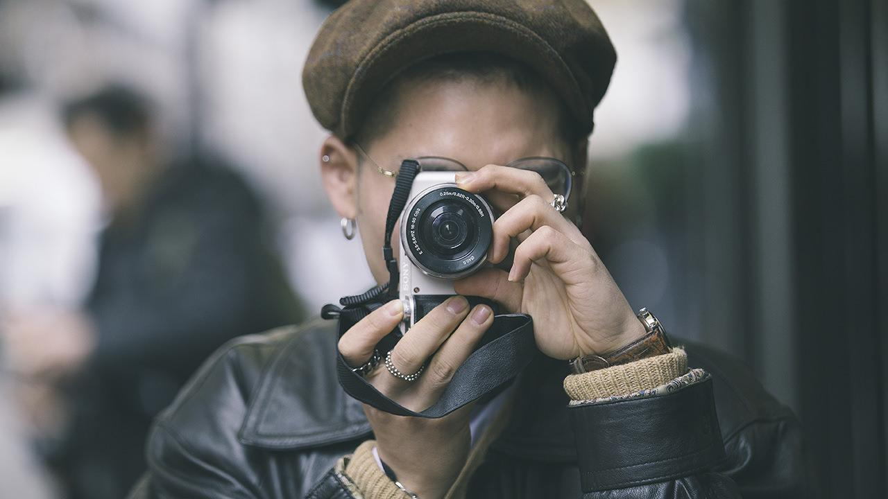
A picture is worth a thousand words
A complex idea can be conveyed with just a single still image, namely making it possible to absorb large amounts of data quickly.

Slide 41

Want big impact? Use big image.

Slide 42
Use charts to explain your ideas
Item 1
Item 2
THE
CONCEPT
Item 3
Item 4

Slide 43
And tables to compare data
As a communication tool, a table allows a form of generalization of information from an unlimited number of different social or scientific contexts. It provides a familiar way to convey information that might otherwise not be obvious or readily understood.
 | A | B | C
Yellow | 10 | 20 | 7
Blue | 30 | 15 | 10
Orange | 5 | 24 | 16

Slide 44
Maps
our office
The word "map" comes from the medieval Latin Mappa mundi, wherein mappa meant napkin or cloth and mundi the world.

Slide 45
89,526,124
Whoa! That’s a big number, aren’t you proud?

Slide 46
And even more numbers
89,526,124$
That’s a lot of money
185,244 users
And a lot of users
100%
Total success!

Slide 47
Our process is easy
last
second
first

Slide 48
Let’s review some concepts
Yellow
Is the color of gold, butter and ripe lemons. In the spectrum of visible light, yellow is found between green and orange.
Blue
Is the colour of the clear sky and the deep sea. It is located between violet and green on the optical spectrum.
Red
Is the color of blood, and because of this it has historically been associated with sacrifice, danger and courage.
Yellow
Is the color of gold, butter and ripe lemons. In the spectrum of visible light, yellow is found between green and orange.
Blue
Is the colour of the clear sky and the deep sea. It is located between violet and green on the optical spectrum.
Red
Is the color of blood, and because of this it has historically been associated with sacrifice, danger and courage.

Slide 49
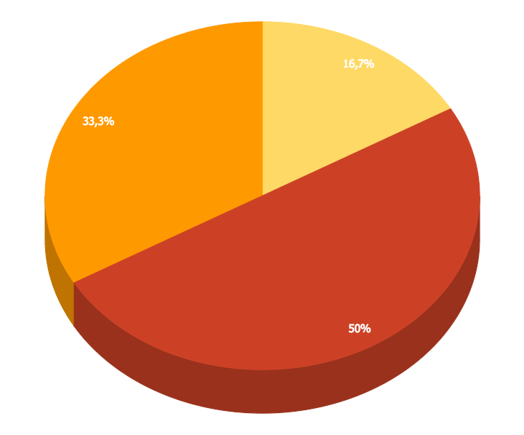
You can insert graphs from Google Sheets

Slide 50
Android Project
Place your screenshot here
Show and explain your web, app or software projects using these gadget templates.

Slide 51
iPhone Project
Place your screenshot here
Show and explain your web, app or software projects using these gadget templates.

Slide 52
Tablet
Project
Place your screenshot here
Show and explain your web, app or software projects using these gadget templates.

Slide 53
Desktop Project
Place your screenshot here
Show and explain your web, app or software projects using these gadget templates.

Slide 54

Thank you very much for your time
If you have any questions about this document please don’t hesitate to contact us at:
www.ourwebsite.com
hello@mail.me
@companyname

Slide 55
Credits
Special thanks to all the people who made and released these awesome resources for free.
Presentation template by SlidesCarnival
Photographs by Unsplash
Learn more about slidedocs at duarte.com/slidedocs

Slide 56
Presentation design
This presentation uses the following typographies and colors:
Titles: Nunito sans
Body copy: Nunito sans
Italic copy: Georgia (system font)
You can download the font on this page:
https://fontlibrary.org/en/font/nunito-sans
Orange #f67031
Yellow #ffa400
Fucsia #ed0036
You don’t need to keep this slide in your presentation. It’s only here to serve you as a design guide if you need to create new slides or download the fonts to edit the presentation in PowerPoint®

Slide 57
SlidesCarnival icons are editable shapes.
This means that you can:
Resize them without losing quality.
Change line color, width and style.
Isn’t that nice? :)
Examples:

Slide 58
😉
Now you can use any emoji as an icon!
And of course it resizes without losing quality and you can change the color.
How? Follow Google instructions https://twitter.com/googledocs/status/730087240156643328
✋👆👉👍👤👦👧👨👩👪💃🏃💑❤😂😉😋😒😭👶😸🐟🍒🍔💣📌📖🔨🎃🎈🎨🏈🏰🌏🔌🔑 and many more...

